Slide 1
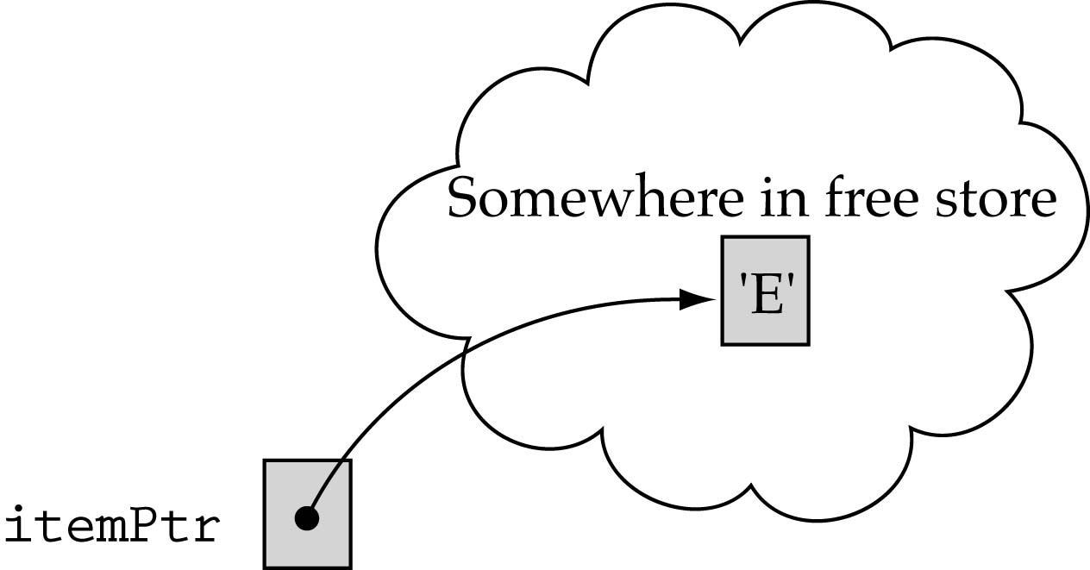
Dynamic allocation of each stack element
Allocate memory for each new element dynamically
ItemType* itemPtr;
...
itemPtr = new ItemType;
*itemPtr = newItem;

Slide 2
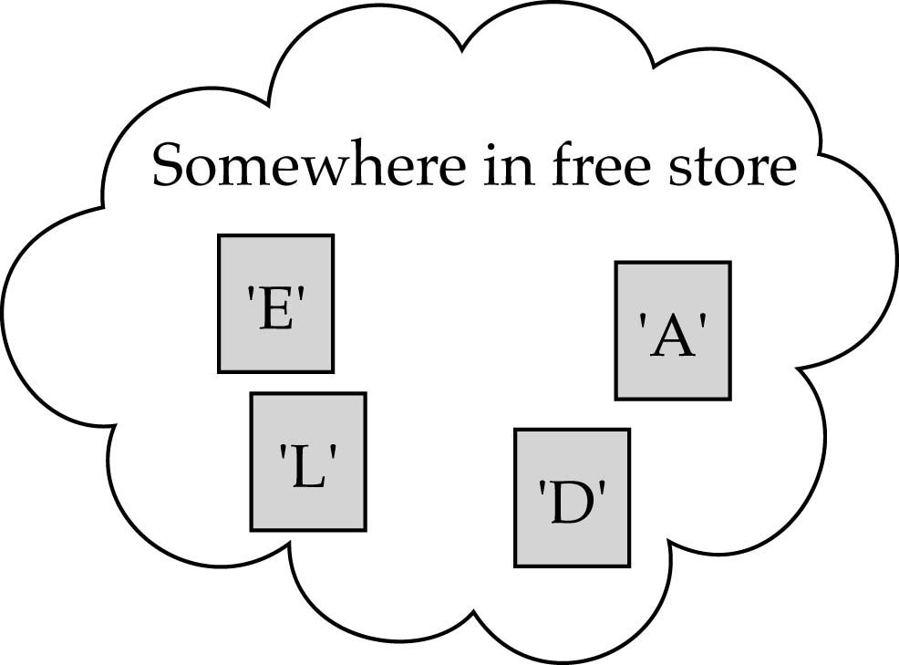
Dynamic allocation of each stack element (cont.)
How should we preserve the order of the stack elements?

Slide 3
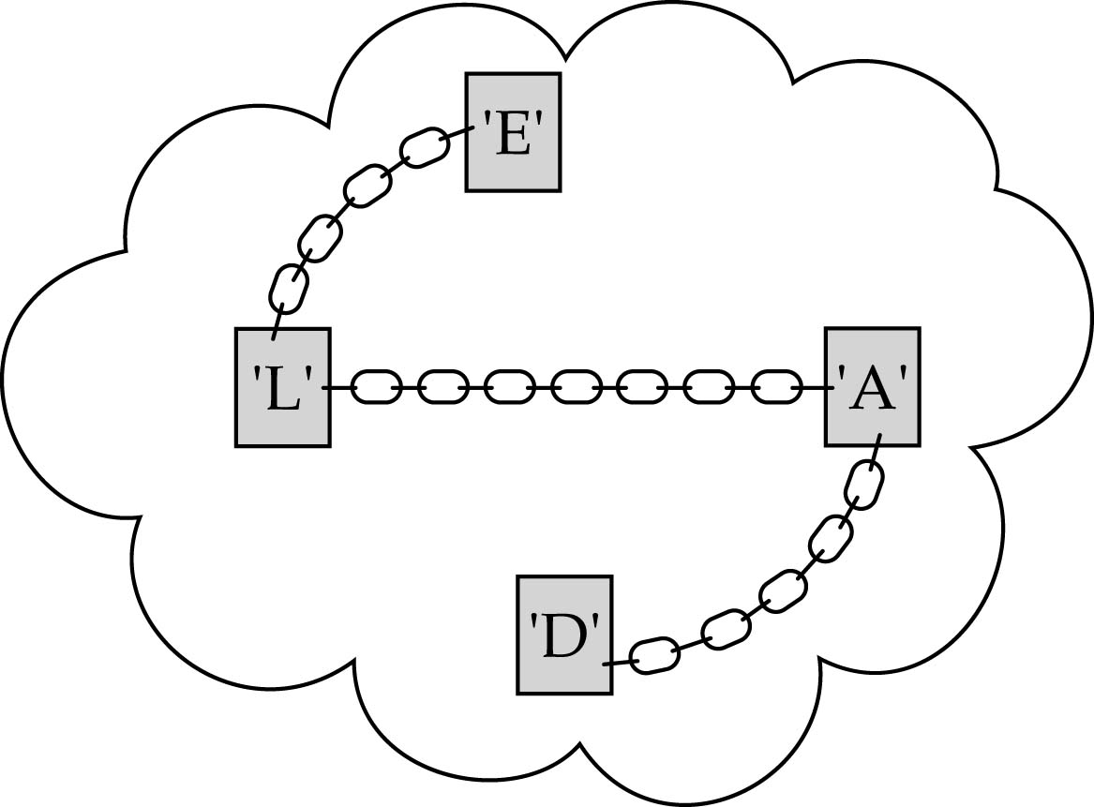
Chaining the stack elements together

Slide 4
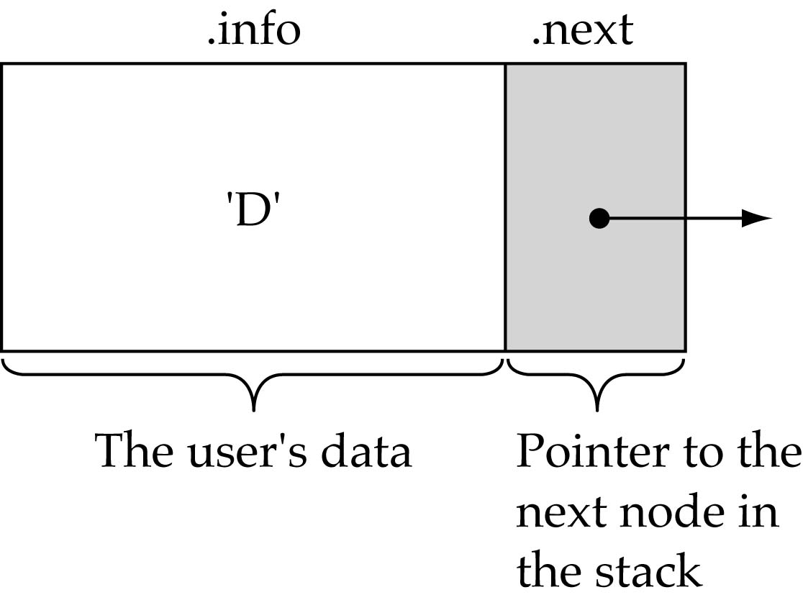
Chaining the stack elements together (cont.)
Each node in the stack should contain two parts:
  info: the user's data
  next: the address of the next element in the stack

Slide 5
Node Type
template<class ItemType>
  struct NodeType {
  ItemType info;
  NodeType* next;
  };

Slide 6
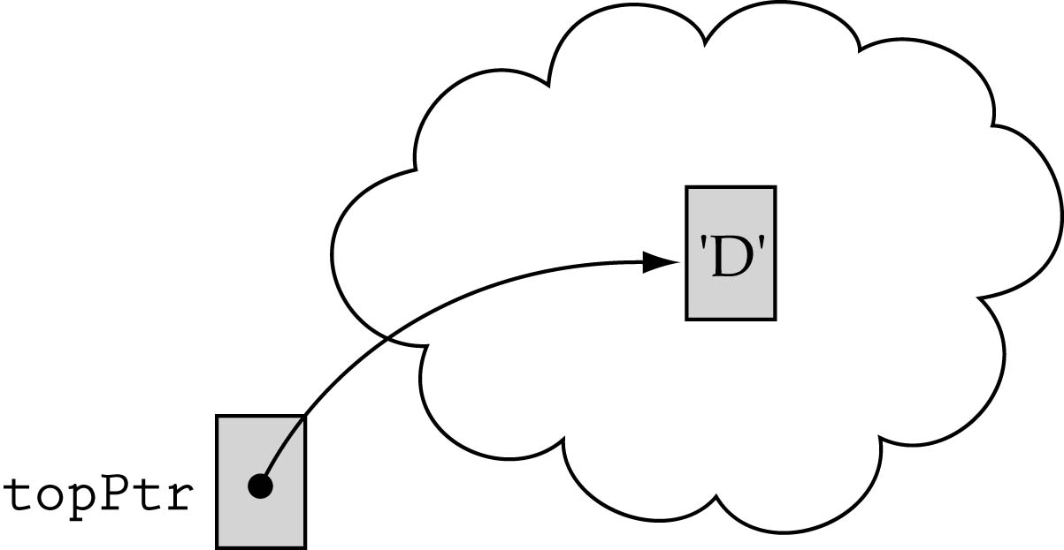
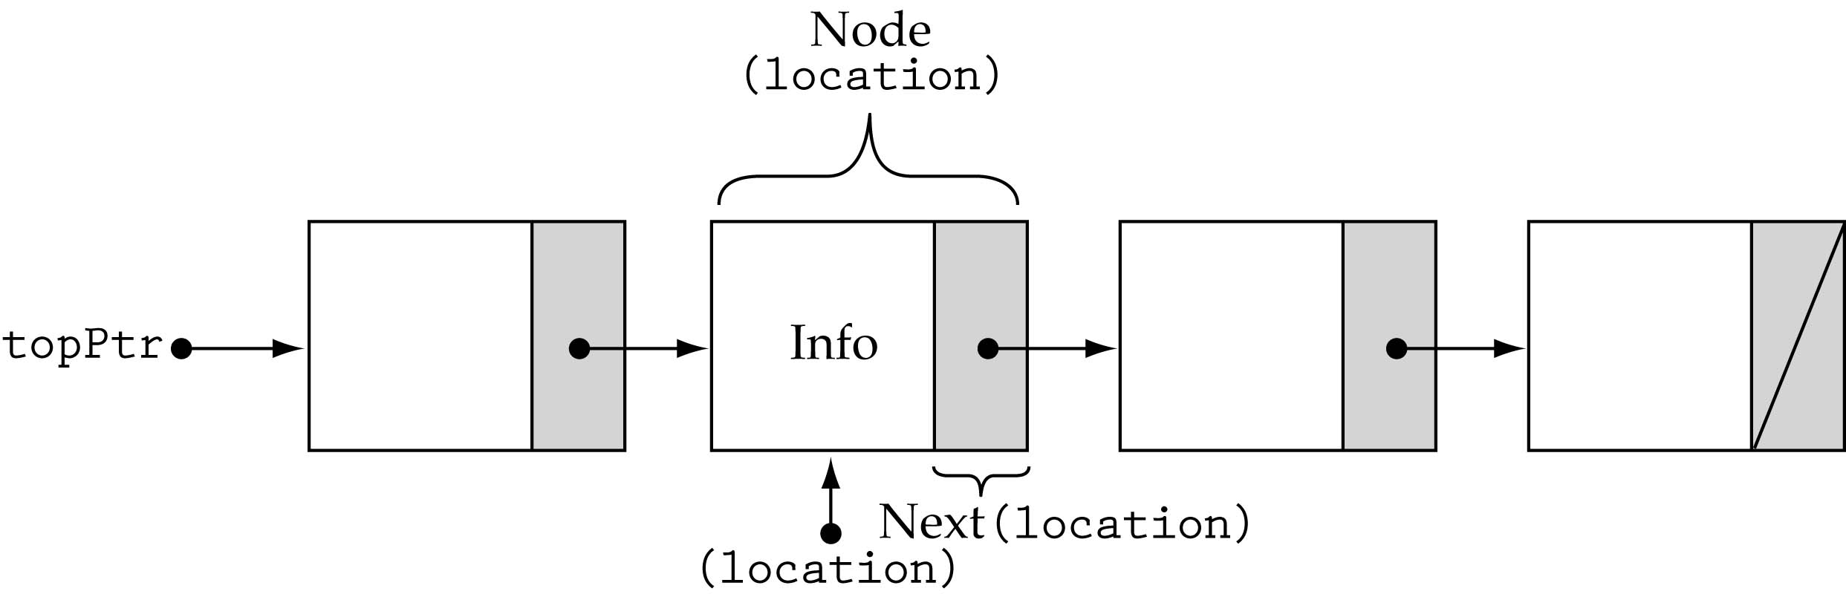
First and last stack elements
We need a data member to store the pointer to the top of the stack
The next element of the last node should contain the value NULL

Slide 7
Stack class specification
// forward declaration of NodeType (like function prototype)
template<class ItemType>
struct NodeType;
template<class ItemType>
class StackType {
public:
StackType();
~StackType();
void MakeEmpty();
bool IsEmpty();
void Push(ItemType);
void Pop(ItemType&);
private:
NodeType<ItemType>* topPtr;
};

Slide 8
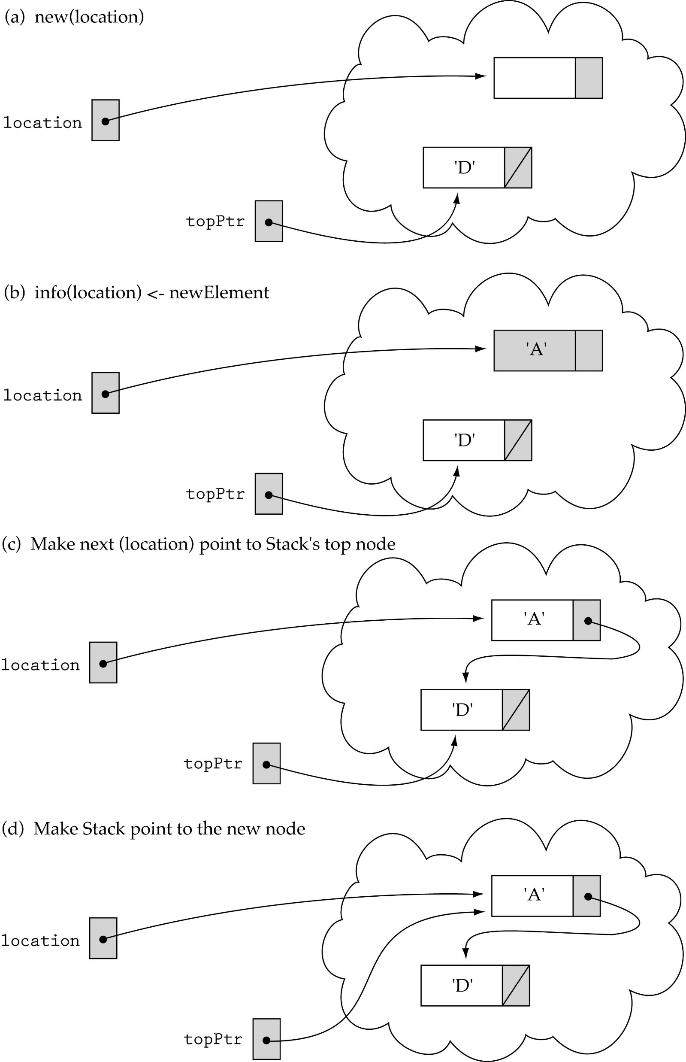
Pushing on a non-empty stack

Slide 9
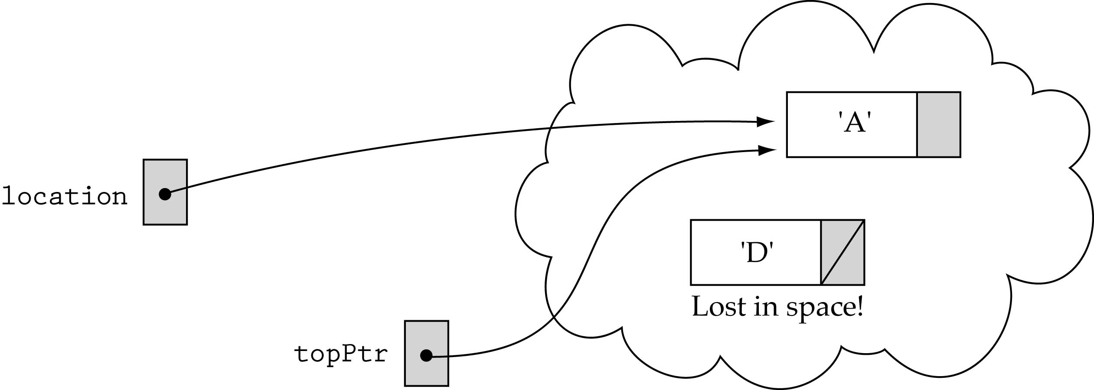
Pushing on a non-empty stack (cont.)
The order of changing the pointers is very important !!

Slide 10
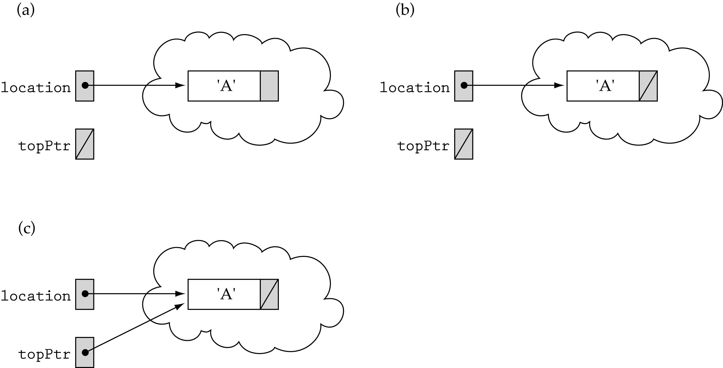
Pushing on an empty stack

Slide 11
Function Push
template <class ItemType>
void StackType<ItemType>::Push(ItemType item)
{
NodeType<ItemType>* location;
location = new NodeType<ItemType>;
location->info = newItem;
location->next = topPtr;
topPtr = location;
}

Slide 12
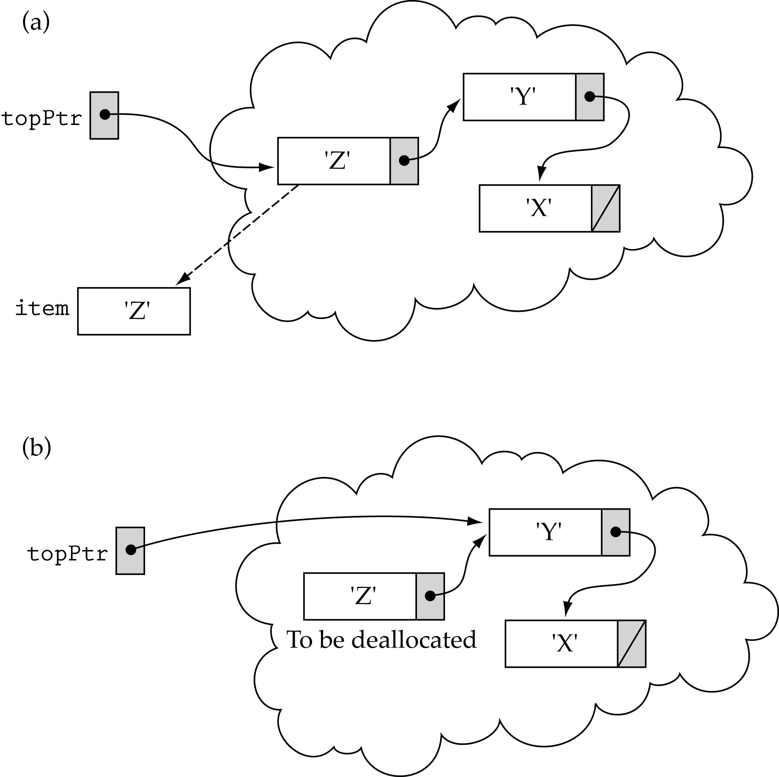
Popping the top element

Slide 13
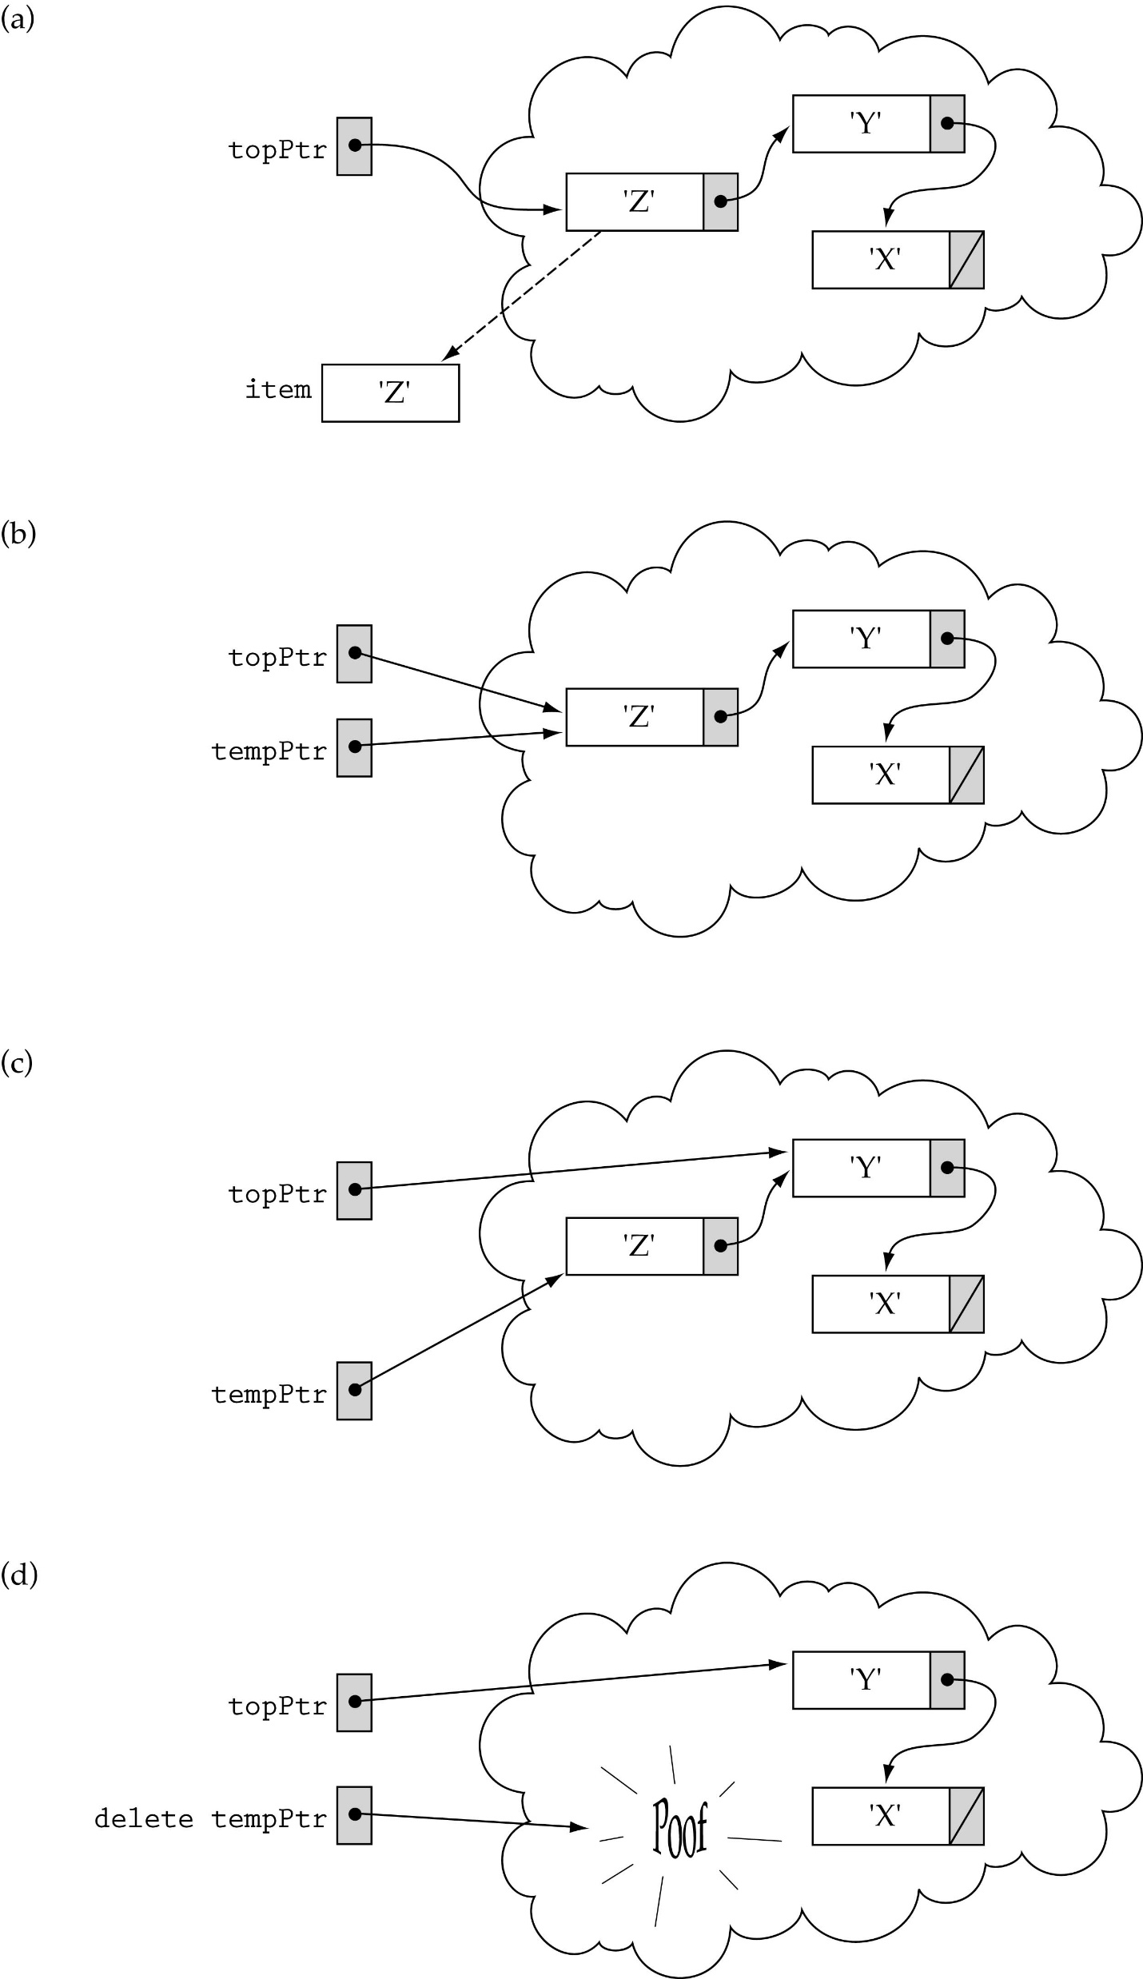
Popping the top element
(cont.)
Need to use a temporary pointer

Slide 14
Function Pop
template <class ItemType>
void StackType<ItemType>::Pop(ItemType& item)
{
NodeType<ItemType>* tempPtr;
item = topPtr->info;
tempPtr = topPtr;
topPtr = topPtr->next;
delete tempPtr;
}

Slide 15
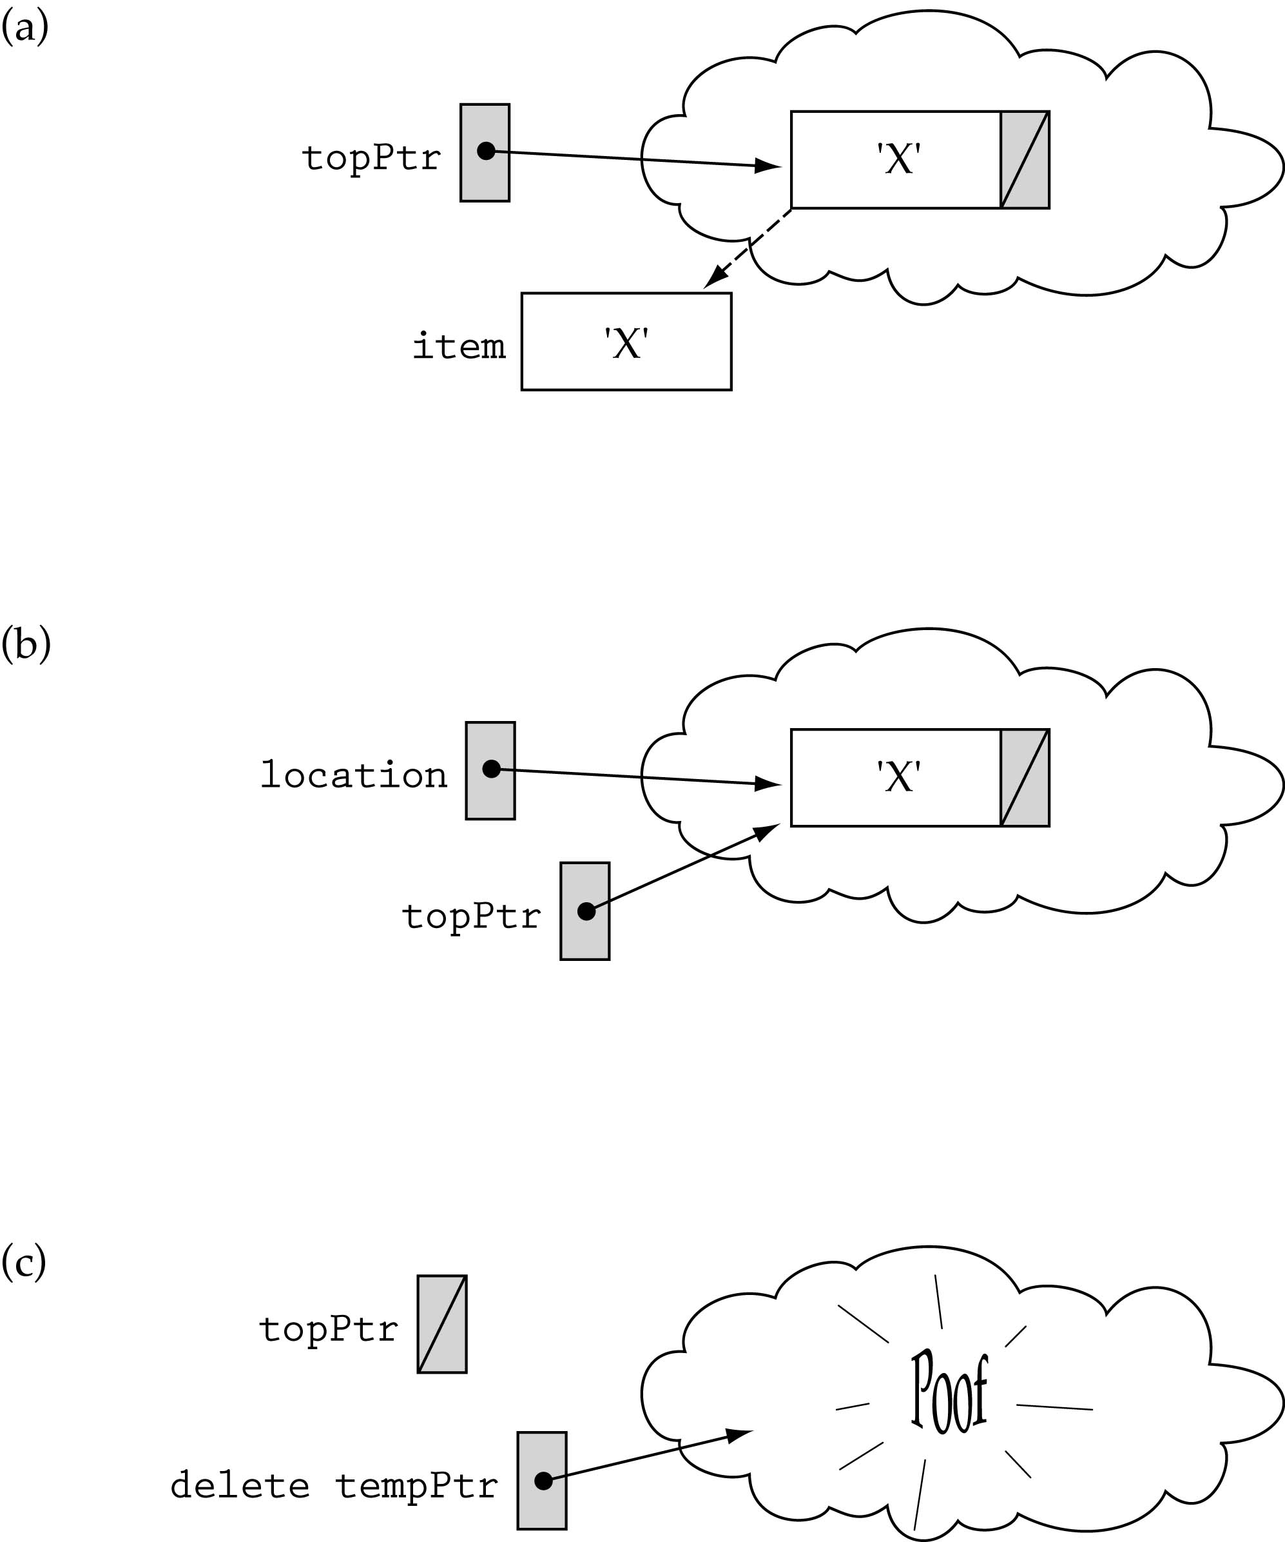
Popping the last element on the stack

Slide 16
Other Stack functions
template<class ItemType>
StackType<ItemType>::StackType()
{
topPtr = NULL;
}
template<class ItemType>
void StackType<ItemType>::MakeEmpty()
{
NodeType<ItemType>* tempPtr;
while(topPtr != NULL) {
tempPtr = topPtr;
topPtr = topPtr->next;
delete tempPtr;
}
}

Slide 17
Other Stack functions (cont.)
template<class ItemType>
bool StackType<ItemType>::IsEmpty()
{
return(topPtr == NULL);
}
template<class ItemType>
StackType<ItemType>::~StackType()
{
MakeEmpty();
}

